Slide 1
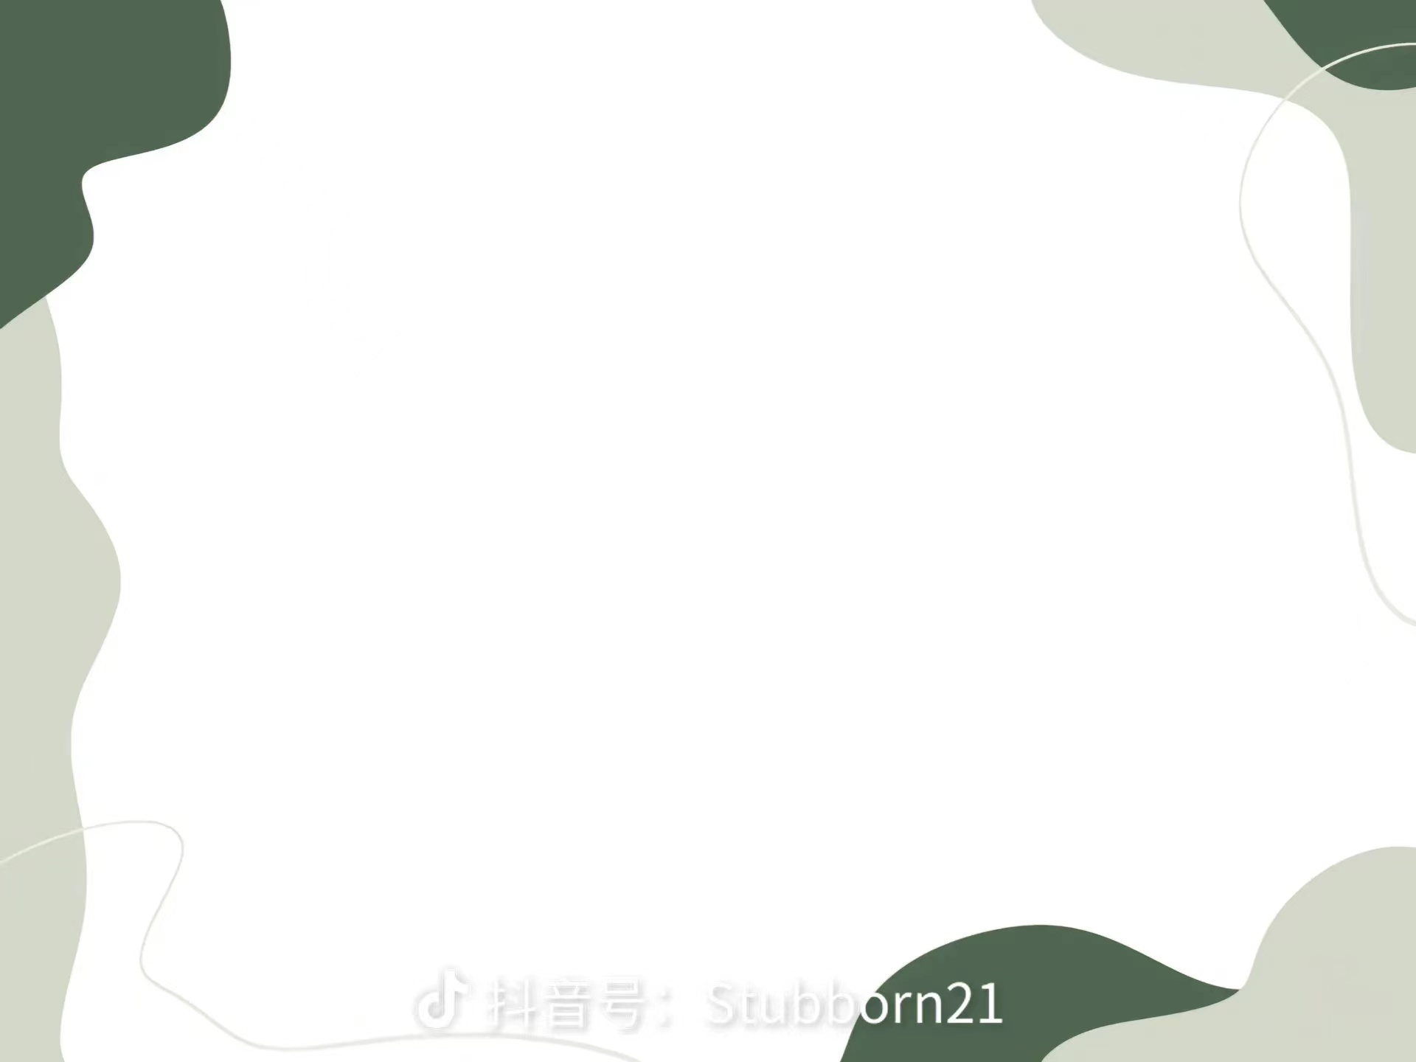
第九段：
Recently I learned that I'm not an isolated case, not the only college student to suffer from credit card chaos. In a time of sky-high tuition costs, many students fall to the temptation of easily accessible credit cards. They are left with tremendous amounts of debt before their lives have even truly begun.
isolated.adj.1.happening only once or existing only one place.
2.(of buildings and places)far away from any others.
例：I felt very isolated in my new job.我在新的工作岗位上觉得很孤独。
chaos. n.(U)a situation in which everything is happening in a confused way and nothing is organized or arranged in oder.
例：He was ultimately overthrown and the economy and creating chaos.他最终被推翻，国家陷入了混乱。

Slide 2
tremendous.adj.1.very big,fast,powerful,etc.
2.excellent.
例:It was a tremendous experience.这是个了不起的经历。
大意：在许多学生真正的生活还没有开始之前，他们就已经背负了巨
额债务

Slide 3
第十段：
Credit card is not the criminal. However, there is a suspicion that credit card companies have provided students with access to debt because they allow young, ignorant consumers without sufficient funds to undertake financial responsibility. To remedy this situation, the screening procedures must become more severe, and college campuses should be free of credit card marketers. If this does not change, many students, like myself, will suffer the consequences of the illusion of a seemingly free but staggeringly expensive $3,000 dictionary.
remedy.v.correct or improve sth.
n.(C)a way of dealing with or improving an unpleasant or difficult situation.
例：There is no simple remedy for unemployment.失业问题没有简单的解决办法。

Slide 4
severe.adj.1.very strict or extreme.
2.extremely bad or serious.
例：The patient suffered severe brain trauma.患者的大脑受到严重
的损伤
illusion.n.(C)a false or wrong belief or idea.
例：Mirrors in a room often give an illusion of space.房间里的镜子
常给人一种空间增大的错觉。
staggeringly.adv.in a way that is very shocking or surprising.
例： The book's 85 colour lithographic plates look staggeringly
fresh and bold. 这本书的85张彩色平版看起来异常鲜艳醒目。
大意：应该采取措施，纠正无力承担经济责任的消费者滥用信用卡的
情况。

